Slide 1

Overall strategy
Align targets to National Policy Statement
Phytoplankton (trophic state)
TN, TP (trophic state)
Ammonium (toxicity)
E. coli (human health)
Cyanobacteria (human health)
Submerged plants (native – ecosystem health)
Submerged plants (invasive – ecosystem health)
Lake bottom DO
Mid hypolimnetic DO
Investigate potential harmful side-effects on
Fish
Macroinvertebrates
Bottom sediments

Slide 2
Range of lake restoration actions
Bubble plume destratification*
Weed harvesting*
Wave barriers
Sediment capping
Floating wetlands*
Phosphorus inactivation*
Oxygenation
Ultrasound*
Hydrogen peroxide
Hypolimnetic siphoning
Dredging*
Surface mixers
Inflow diversion*
Inflow flushing*
Grass carp introductions*
* Currently or previously used in New Zealand

Slide 3
Lake restoration actions
Bubble plume destratification
Weed harvesting
Wave barriers
Sediment capping
Floating wetlands
Phosphorus inactivation
Oxygenation
Ultrasound
Hydrogen peroxide
Hypolimnetic siphoning
Dredging
Surface mixers
Inflow diversion
Inflow flushing
Grass carp introductions

Slide 4
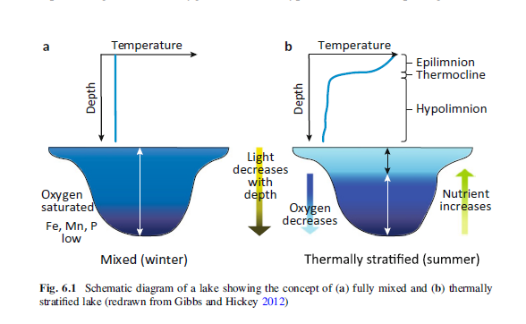
Bubble plume destratification
Issue: Vertical transfer of heat, dissolved oxygen and nutrients greatly reduced as lake stratifies
Effects: Stratification causes
Deoxygenation of lower water layer and bottom sediments (depending on oxygen depletion in the bottom layer)
Increased nutrient release associated with anoxia
May lead to dominance of buoyant, cyanobacteria, leading to blooms

Slide 5
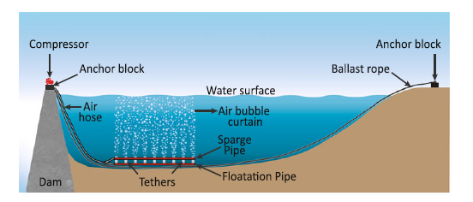
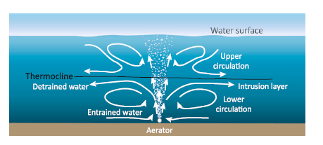
Bubble plume destratification Method

Slide 6
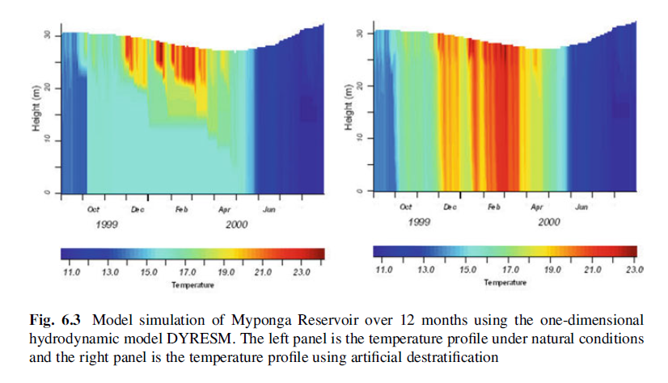
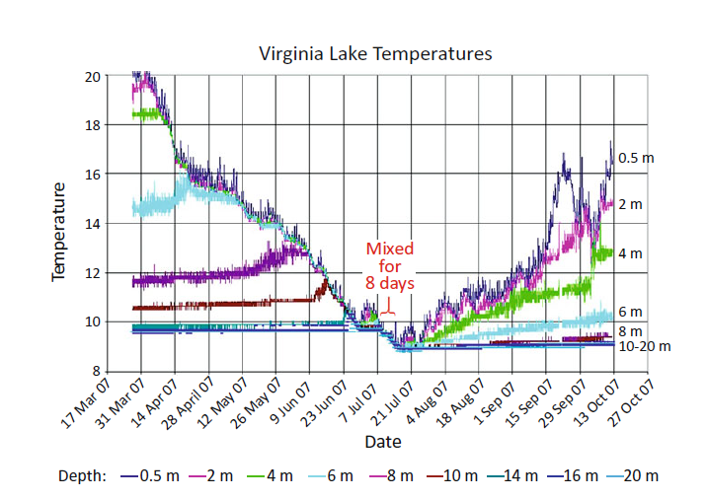
Bubble plume destratification Expected effects
Destratification
Increased oxygen in bottom waters
and sediments
Reduced releases of nutrients

Slide 7
Bubble plume destratification Difficulties
Timing
Recommended to begin destratification during mixed phase (in both polymictic and monomictic lakes)
Destratification effect: physical: immediate, ecological change: varies (e.g., phytoplankton communities)
Long term: deep re-oxygenation of bottom sediments
Destratification can be incomplete (Sherman et al.)
Disturbance of bottom sediments from bubble plumes (when first switched on)
Increased oxygen demand of bottom sediments from increased temperature
(Re)-distribution of nutrients and phytoplankton through the water column; concentrations may be higher with destratification for some cases (Sherman et al.)

Slide 8
Bubble plume destratification Monitoring implications (split into effect-based monitoring (positive) and negative (side effects))
Continuous (high-frequency sensors)
Temperature
Thermistor chain(s) throughout water column at distances where it is desirable to achieve destratification
DO
At least one sensor in the lower water layer
Additional oxygen sensors for surface waters
Optional: Chlorophyll and/or phycocyanin fluorescence
Surface sensor, calibrated

Slide 9
Bubble plume destratification Monitoring implications
By sampling
Nutrient profiles
Complement routine (e.g., monthly) sampling (TN, TP, PO4-P, NOX-N, NH4-N, clarity) with increased frequency before and after (~1 month) implementation
Phytoplankton fluorescence profiles combined with chlorophyll a and cell counts
Zooplankton (as indicator of recovery)
Monitor sediment resuspension (suspended solids, turbidity in deeper waters)

Slide 10
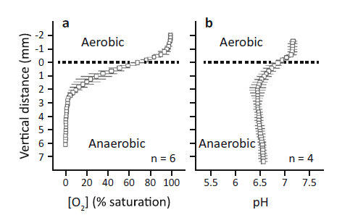
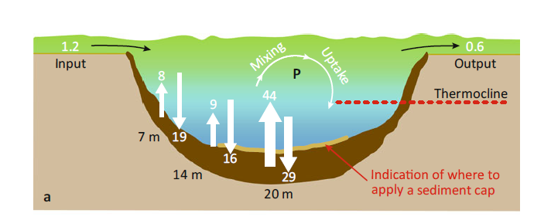
Phosphorus inactivation
Issue: High phosphorus concentrations lead to eutrophication
Seasonal stratification leads to anoxia of bottom waters and phosphorus releases from bottom sediments

Slide 11
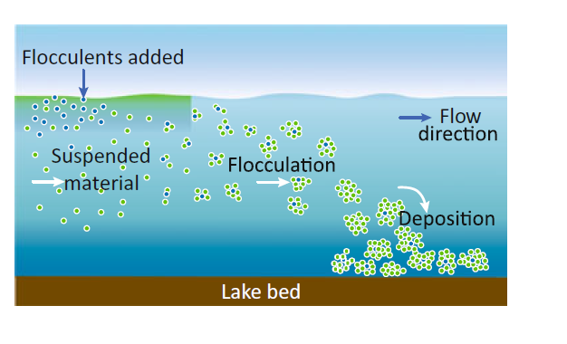
Phosphorus inactivation Method
Add Alum (aluminium sulphate), Phoslock (lanthanum-enriched bentonite) or Aqual-P (modified zeolite)
Suspended P flocculates -> deposition in sediment
Activated sediment flocculant designed to reduce P releases

Slide 12
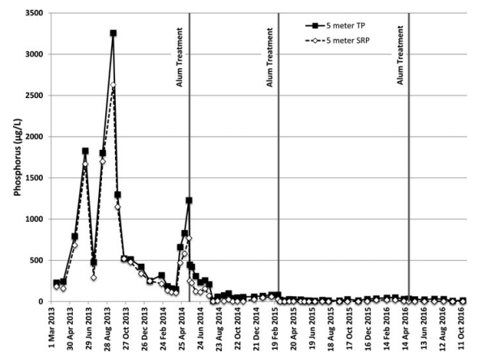
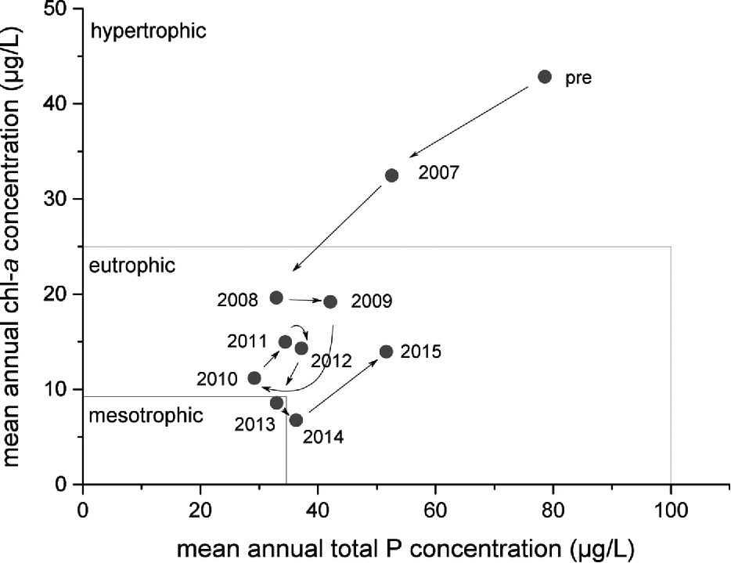

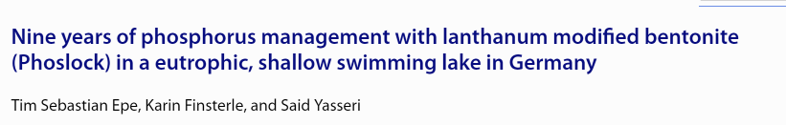
Phosphorus inactivation Expected effects
Reduced reactive P – both in water column and in bottom sediment

Slide 13
Phosphorus inactivation Difficulties
Changes in grazing pressure (use zooplankton as ecological indicator)
Phoslock:
Settling speed (hours to days)
Can settle on macrophytes – does not reach bottom sediment
Potentially toxic to juvenile fish/zooplankton/macroinvertebrates
Suppression of nitrification
Acute toxicity:
Loss of buffering with excessive Al doses can create high levels of acidity and fish kills. Shock doses likely require buffering.

Slide 14
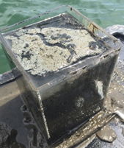
Phosphorus inactivation Monitoring: effectiveness
Phosphorus-focused monitoring: multiple timescales
Short term – monitoring of flocculation (sediment traps + visual survey), water column measurements
Medium term – measurements in the water column
Long term – monitoring of P trends in sediment – bottom-sediment composition and potential releases?

Slide 15
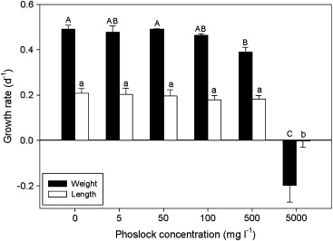
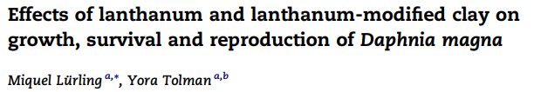
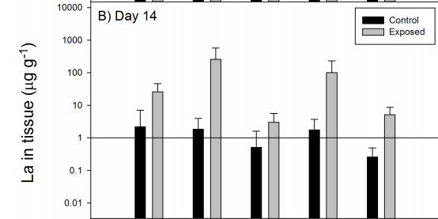
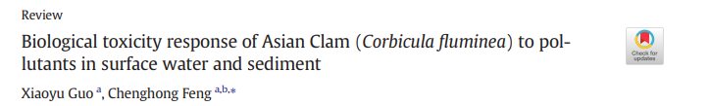
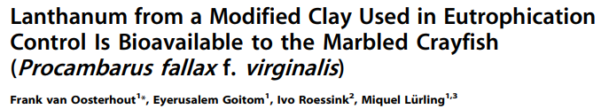
Phosphorus inactivation Monitoring: side effects
Fish
Effects of Phoslock on juveniles
pH effects: potential acute toxicity
Zooplankton (short scale)
Can get trapped in flocculation clusters
Potential to interfere with growth rates
Benthic invertebrates
Bioaccumulation has been demonstrated in crayfish and Asian clam
Potential effects on kakahi?

Slide 16
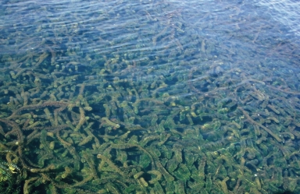
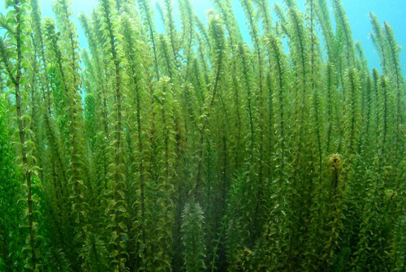
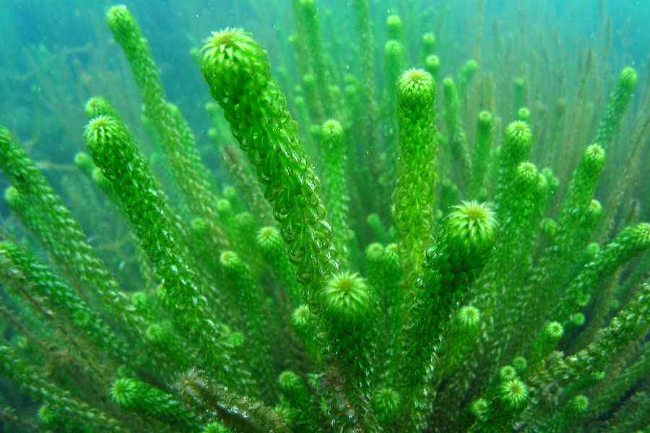
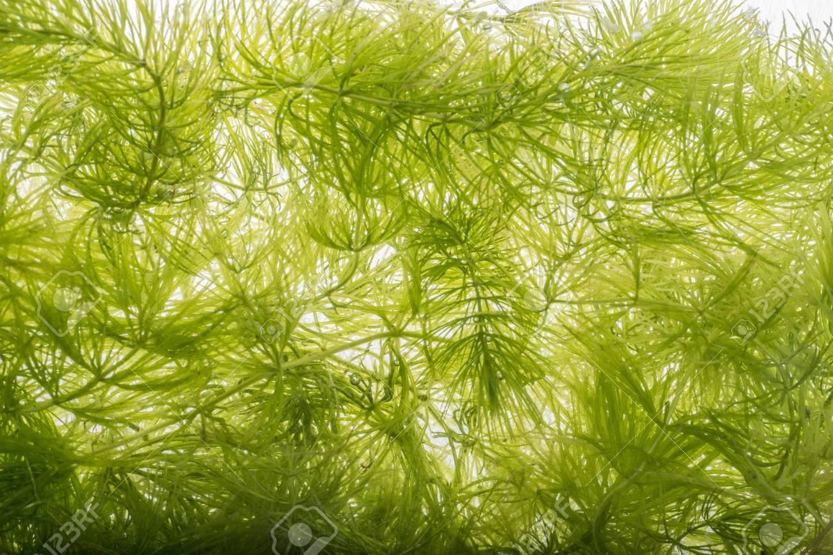
Weed removals
Egeria densa
Elodea candensis
Lagarosiphon major
Ceratophyllum demersum

Slide 17
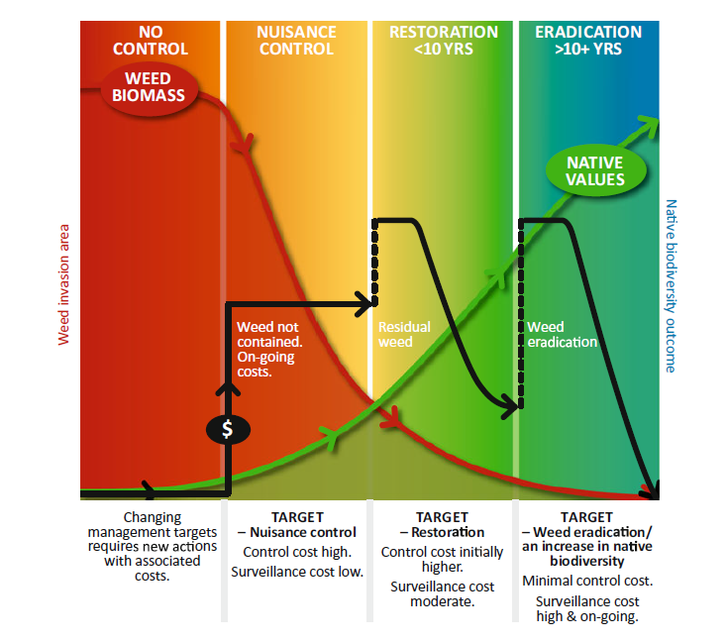
Weed control
A long-term undertaking using harvesting

Slide 18
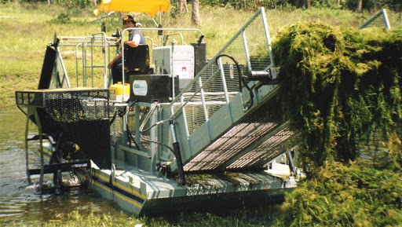
Weeds Two control mechanisms
Weed harvesting

Slide 19
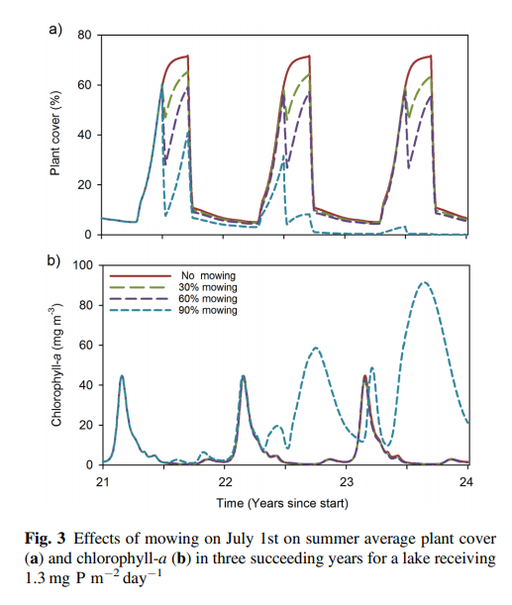
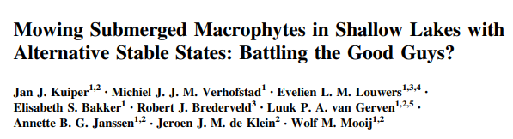
Weed harvesting Difficulties
Potential to ‘flip’ the lake into different state
Instead of being sequestered, nutrients can stay in the water column
Timing of harvesting can optimise both weed and nutrient removal

Slide 20
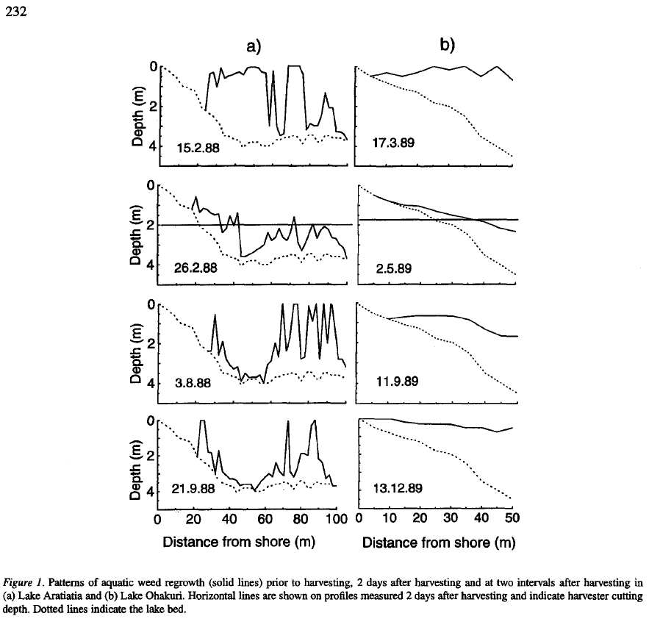
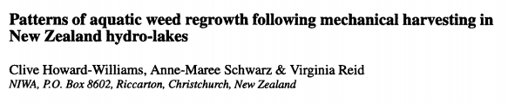
Weed harvesting Monitoring: effectiveness
Weed surveys

Slide 21
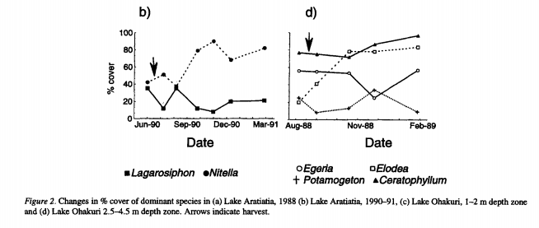
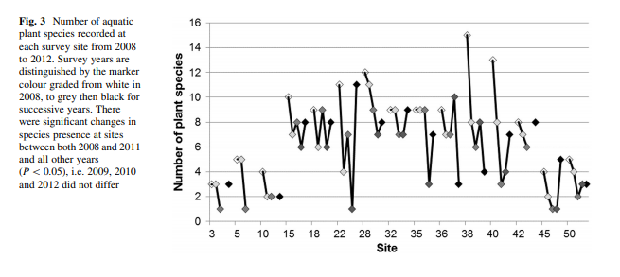
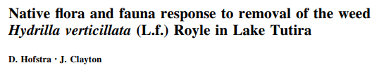
Weed harvesting Monitoring implication: side effects
Nutrients in water/nutrients in weeds
Wet vs dry weight
TN/TP
Before/after harvesting
Species composition
Weed species (some can increase)
Native plant species (can decrease)

Slide 22
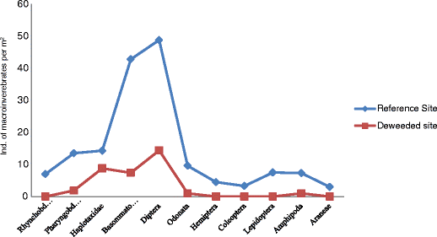
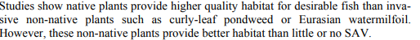
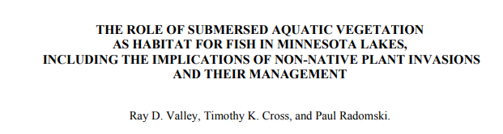
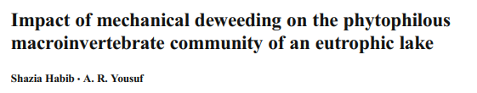
Weed harvesting Monitoring implication: side effects
Optionally fish/invertebrates

Slide 23
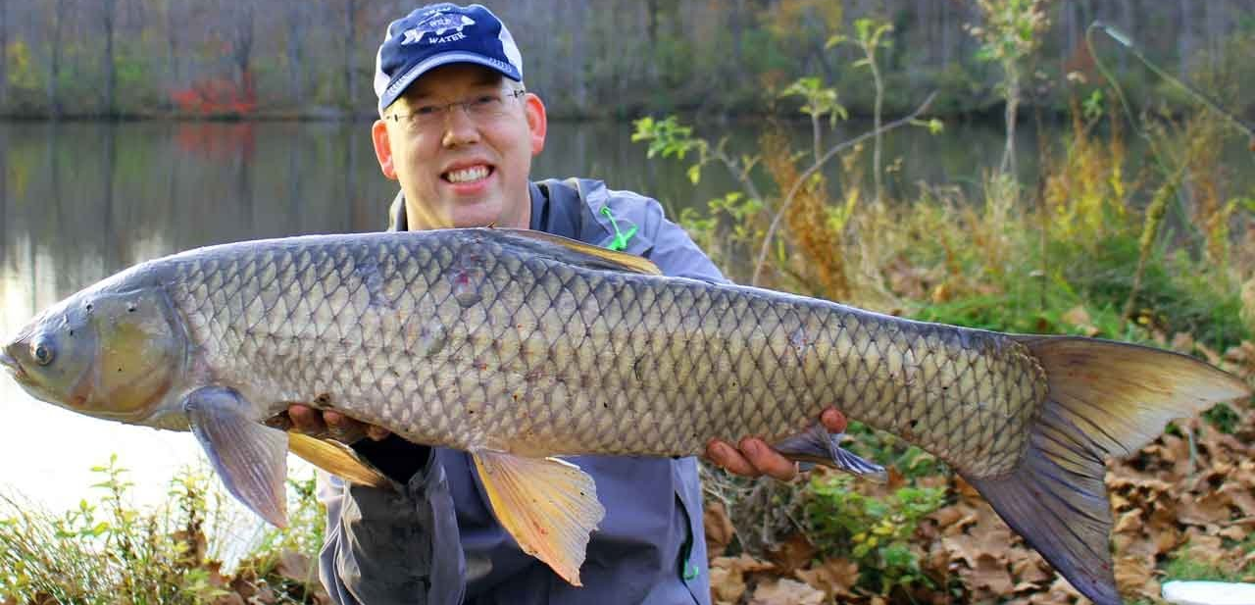
Weeds Two control mechanisms
Weed harvesting
Grass Carp (Ctenopharyngodon idella)

Slide 24
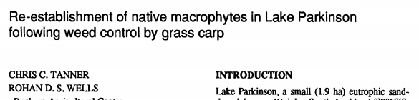
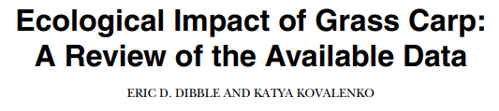
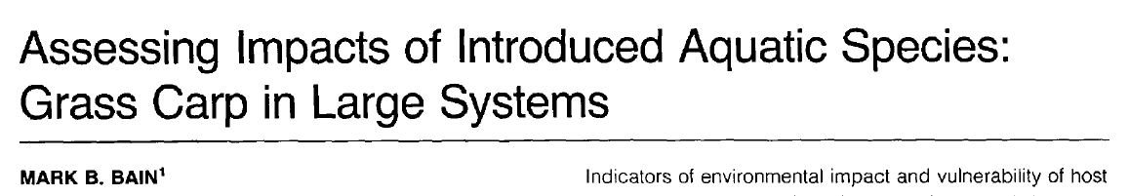
Grass carp Difficulties
Grass carp can also decimate native aquatic plants
Other effects of grass carp are not widely studied, but some indications of
Transmission of parasites
Changes in water quality, increased phytoplankton density
Shifts in macroinvertebrate communities
Reduced waterfowl by removal of macrophytes
Altered trophic structure
Removal of grass carp

Slide 25
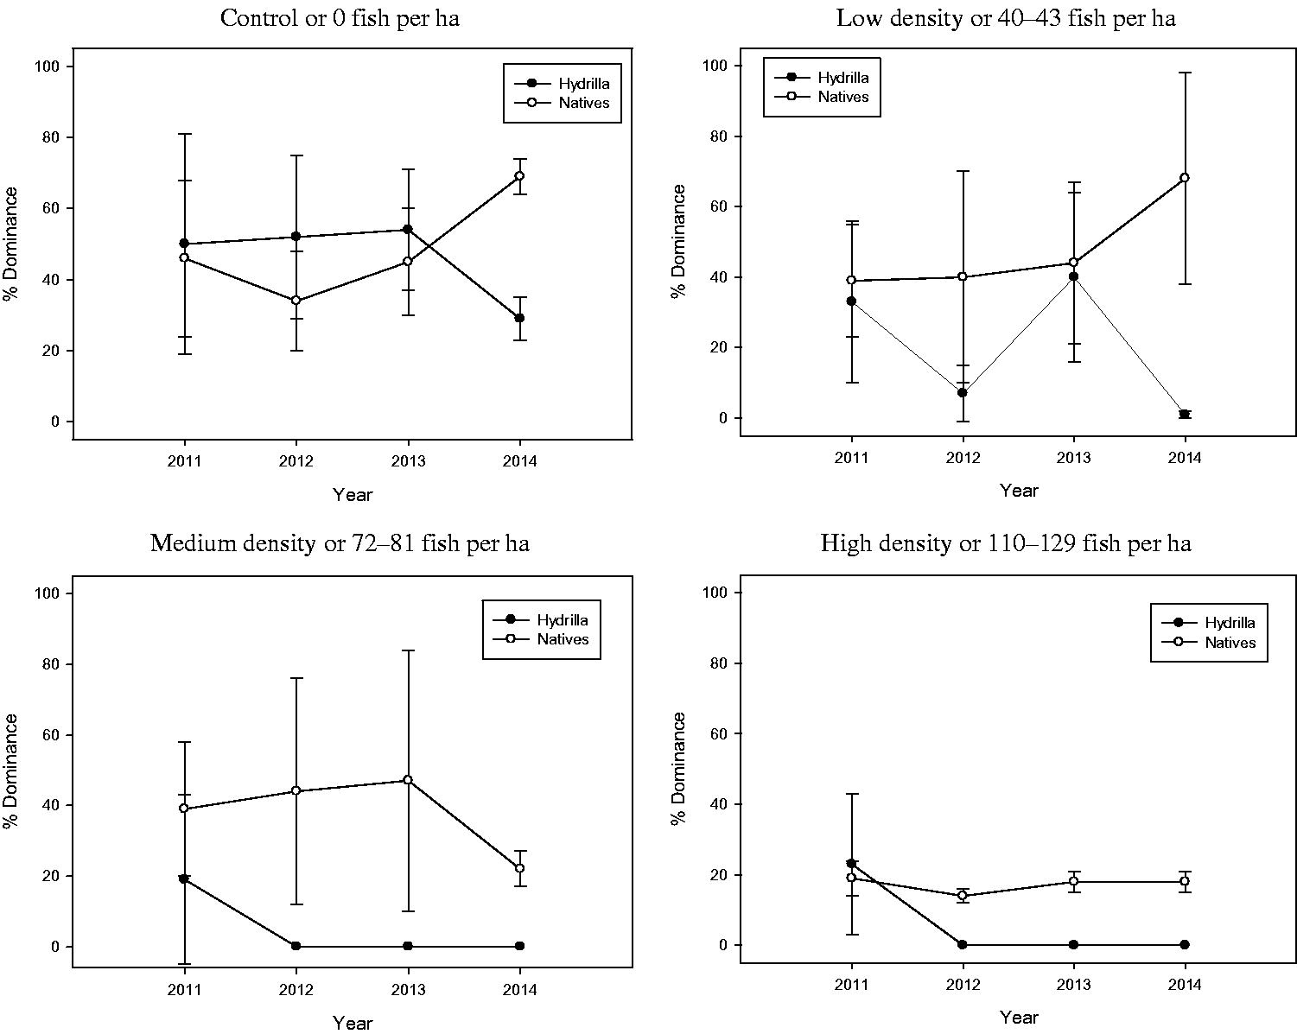
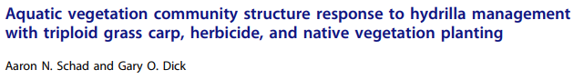
Grass carp Monitoring: effectiveness
Weed surveys
Adaptive management to determine optimal stocking density

Slide 26

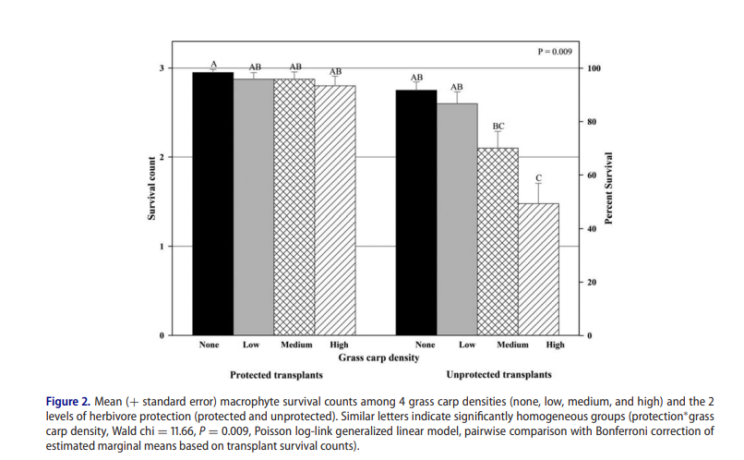
Weed harvesting Monitoring: side effects
Trophic status (TN/TP)
Species composition
Weed species
Native plant species (LakeSPI)
Benthic communities (change in structure)

Slide 27
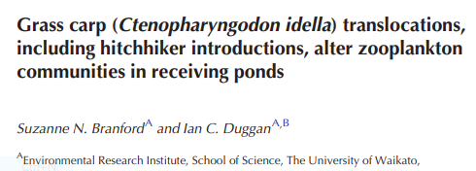
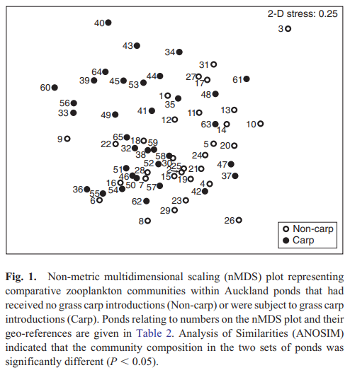
Weed harvesting Monitoring implication: side effects
Potentially additional monitoring for
Zooplankton species composition

Slide 28
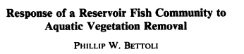
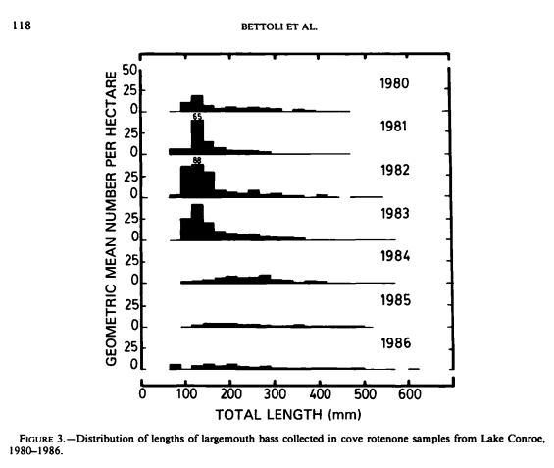
Weed harvesting Monitoring implication: side effects
Potentially additional monitoring for
Zooplankton species composition
Fish communities and size classes

Slide 29
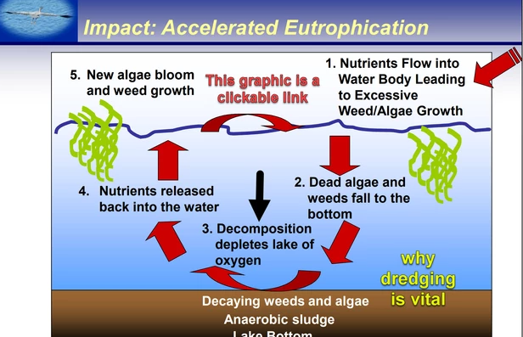
Dredging Issue

Slide 30
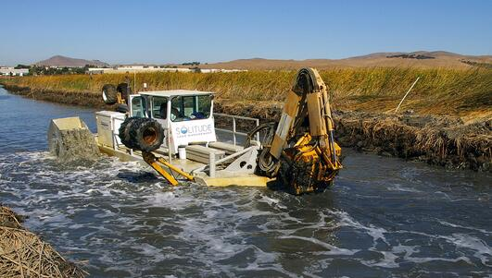
Dredging Method/effect
Mechanical nutrient/sediment removal

Slide 31
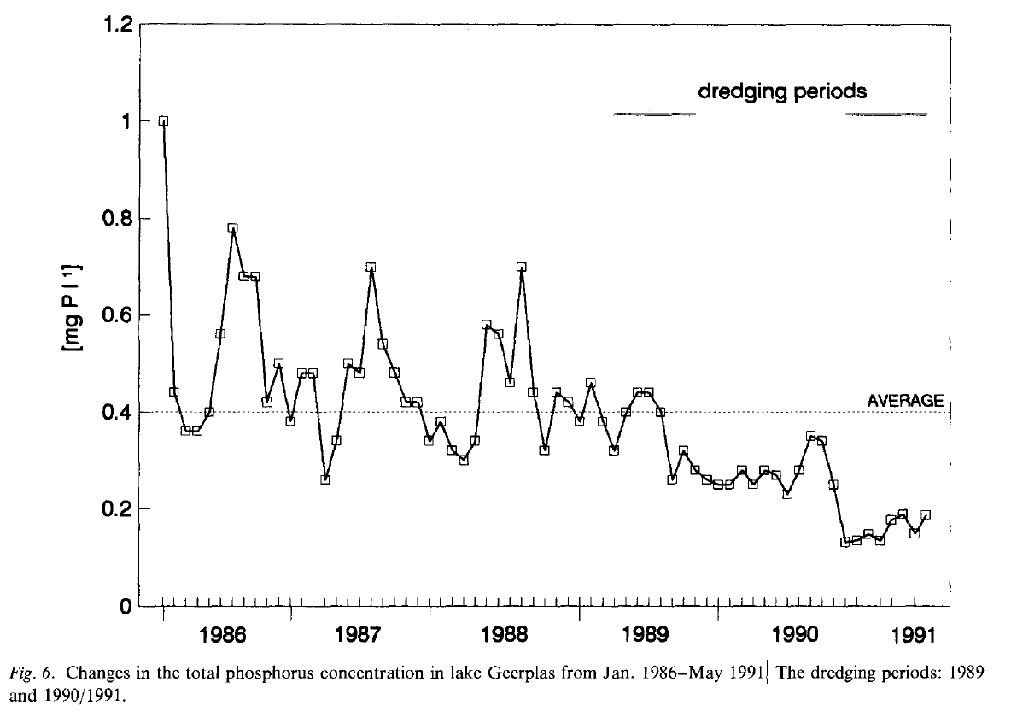
Dredging Expected effects
Reduced reactive P – both in water column and in bottom sediment at longer durations

Slide 32
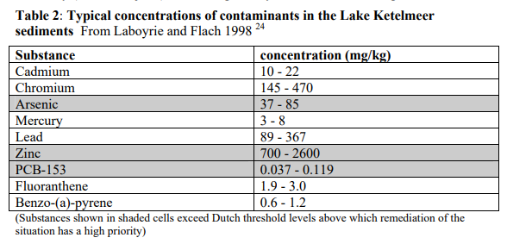
Dredging Difficulties
Continuing maintenance
3-year recurrence (Liu et al 2016)
Issues with dredging disposals
PCP and PCDDs/PCDFs
Heavy metals
Issues with remobilization
Sediments (turbidity)
Heavy metals
Impact on biota (can be mitigated though)
Mussels
Fish

Slide 33
Dredging Monitoring: effectiveness
Monitor nutrients and total suspended solids in water column

Slide 34
Dredging Monitoring: side effects
Heavy metal assays
Benthic biota
Inverts
Kakahi
Fish

Slide 35
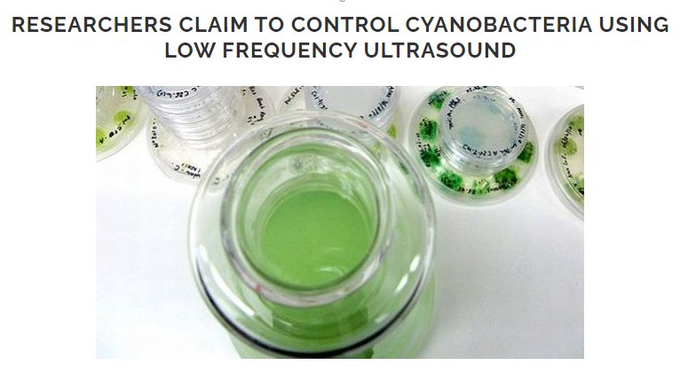
Ultrasonic Issue

Slide 36



Ultrasonic Method/effect

Slide 37

Ultrasonic Expected effects (note – almost all in lab)

Slide 38
Ultrasonic removal of BG algae Difficulties
Continuing maintenance
Has to recur every 3 years (Liu et al 2016)
Issues with dredging disposals
PCP and PCDDs/PCDFs
Heavy metals
Issues with remobilization
Sediments (turbidity)
Heavy metals
Impact on biota (can be mitigated though)
Mussels
Fish

